Slide 1


Air Force Institute of Technology
NENG 791 – Proliferation of Weapons of Mass Destruction
Signatures of Nuclear Proliferation Activities
Lt Col Fee
E d u c a t i n g t h e W o r l d ’s B e s t M i l i t a r y
Notes:
Welcome to the penultimate block of instruction on nuclear proliferation.

Slide 2
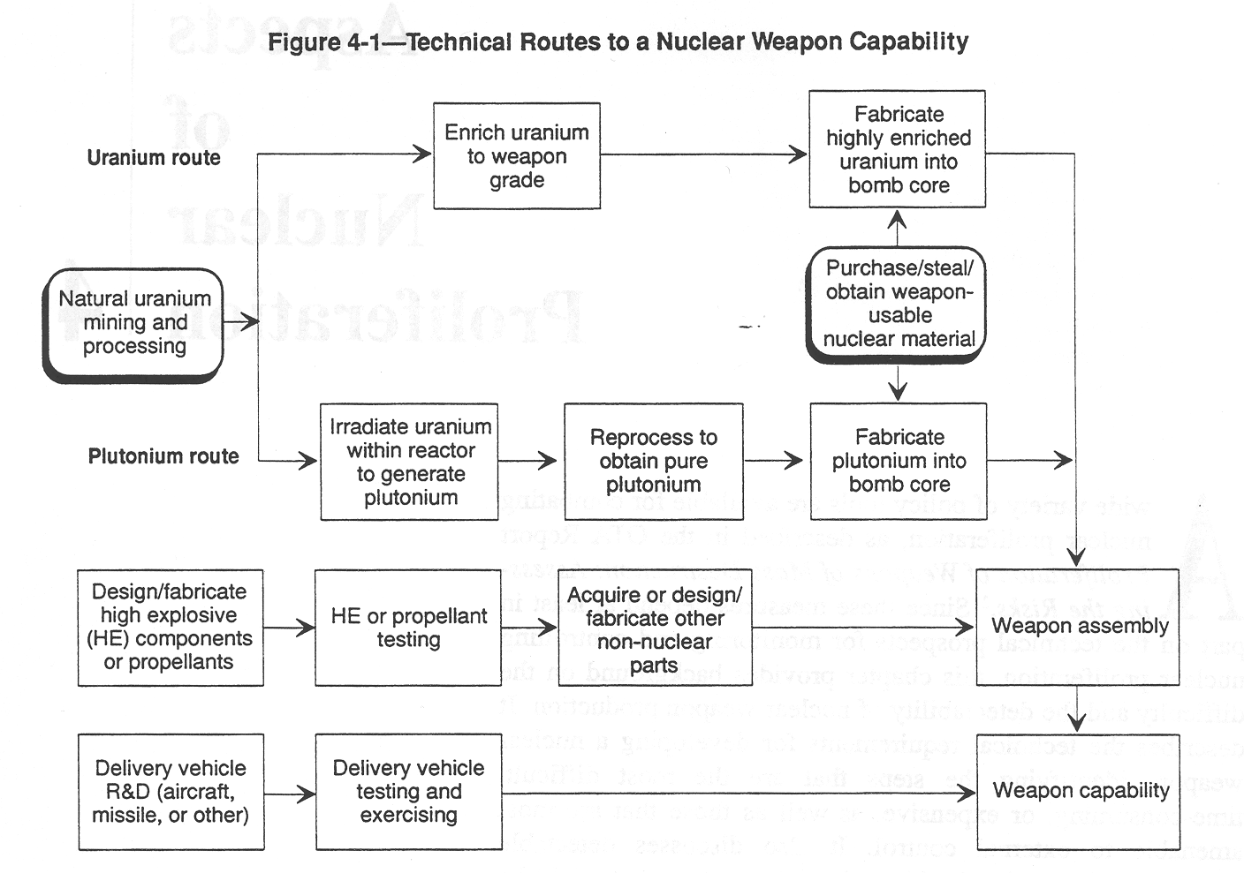
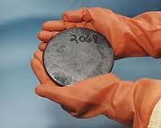
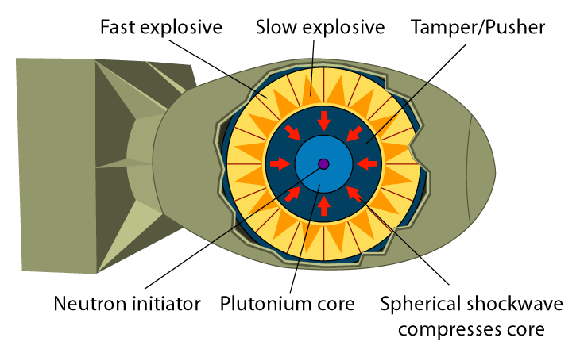
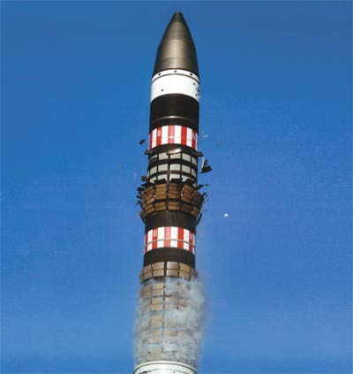
Technical Routes to a Nuclear Weapon
1
2
3
Major Steps
Obtain special nuclear material
Integrate high explosive components
Integrate delivery system
Notes:
Here we see the different steps on the technical routes to a nuclear weapon.
How does stealing enriched material allow you to bypass steps?

Slide 3
Outline Signatures of Nuclear Proliferation Activities
Technical Knowledge and Personnel
Obtaining Fissile Material
Materials Acquisition
Weapon Design and Intent
Weapon Testing
Atmospheric Detection of Pathways
Export Controls
Assessing the Phenomenon of Nuclear Trafficking
Notes:
Here are the major areas we will talk about today.
Is technical knowledge and personnel with the requisite knowledge difficult to obtain?
Much of the technical knowledge is “out there.”
As many of you will remember from NENG 605, Bombs I, development of the PSW (Petrosky Stupid Weapon), while impractical was not difficult to do.
For a non-state actor, what type of weapon might they choose?
They will almost certainly concentrate on a gun-type device.
For a state actor, what type of weapon might they choose?
We need to consider both for the state actor.
Does a proliferator need to test a weapon? Will they?
Given the scarcity of material, it is doubtful that a non-state actor would waste material on a test.
In any event, for a gun type weapon, there is not likely to be a test.
While we will look at atmospheric detection of pathways, there are certainly other environmental pathways that might be promising to look at.
The assessing the phenomenon provides you some insights into the scope of the problem and the difficulties involved.

Slide 4
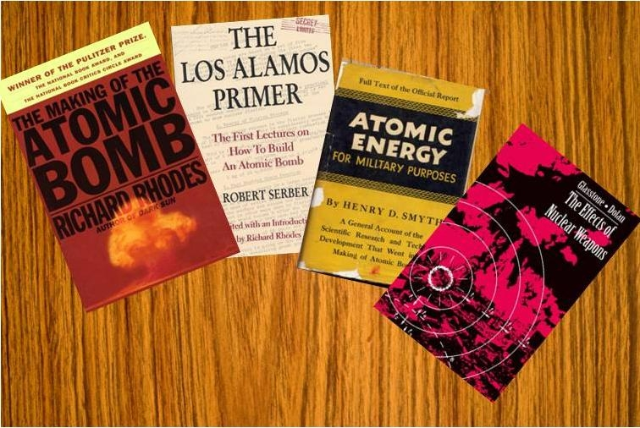

Technical Knowledge and Personnel
Basic nuclear weapon design information is widely available
Internet
Written books in open publication
The Manhattan Project spawned a new academic discipline – Nuclear Engineering
Undergraduate and graduate education
U.S.
Nearly 60 years in dozens of universities
Enrollment of foreign nationals
Atoms for Peace
Graduates returned to their native countries to start nuclear engineering programs
Strong academic programs in Europe, Japan, China and India (and others)
Technical knowledge and personnel are universal
Notes:
As we previously stated, much of the expertise needed to develop a weapon is “out there.”
If you look at the composition of our undergraduate and graduate institutions, you will note that many countries, including our adversaries, send their students to earn their education in the states.
Our program at AFIT is unique because it is US-only.

Slide 5
Obtaining Fissile Material
Purchase or theft
Concerns associated with dissolved Soviet Union
Weapons and launchers located in Russia, Belarus, Kazakhstan, and Ukraine
Loss of centralized control of nuclear weapons
Displaced scientists
Non-NPT states
Diversion or theft from civilian activities
Commercial power reactors are neither the most vulnerable nor fruitful sites for diverting nuclear materials
Storage of material from dismantled U.S. and Russian warheads
Reactor fuel reprocessing plant
HEU from research reactors
Indigenous production
Large, complex and expensive set of specialized facilities
Begins with uranium ore processing (uranium and plutonium )
Notes:
Purchase or theft of nuclear material is certainly a significant risk.
This is one of the reason while virtually all US politicians fall on the same side of safeguarding materials and working with other countries to reduce the threat.
Why are commercial power reactors neither the most vulnerable or most fruitful sites for diverting nuclear materials?
Would you consider the storage of material from dismantled US and Russian warheads a significant risk?
Why might a reactor fuel reprocessing plan or HEU from a research reactor be a better bet for proliferation?
Is a non-state actor likely to be successful with an indigenous production facility?
What kind of indicators might alarm us to the presence of a clandestine facility?
Specialized materials
HUMINT
Unexplained expenditures.

Slide 6
Materials Acquisition – Diversion
Uranium or plutonium diversion from safeguarded facilities would generate strong suspicions of a nuclear weapon program
Safeguards
Containment: various seals broken at Natanz centrifuge plant (5/24/2011)
Surveillance: video cameras and motion detectors
Materials accountability: seeks to verify correctness of a plant’s operating records
Behaviors detectable through normal safeguards inspection
Stalling tactics
Complaints about individual inspectors
Repeated exclusion of inspectors with certain nationalities (a right under IAEA safeguards)

Slide 7
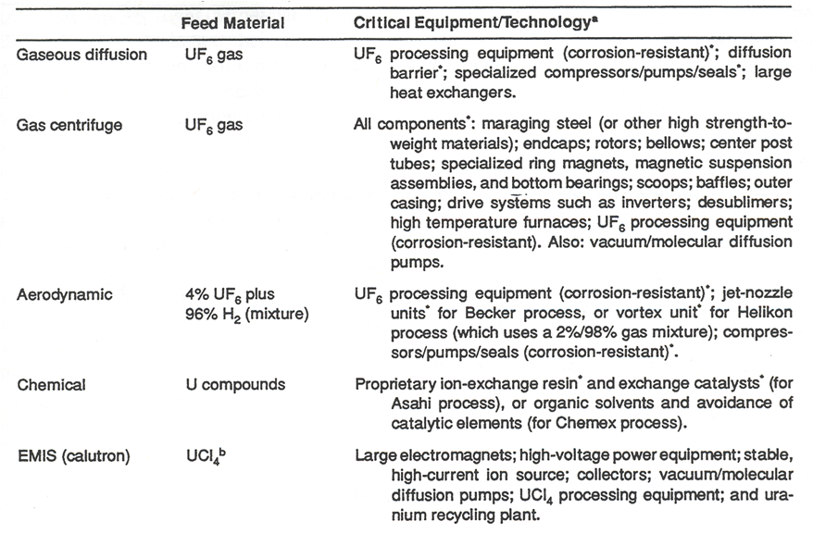
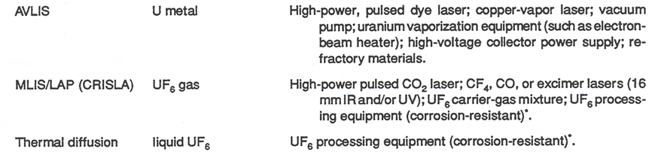
Materials Acquisition – Uranium Enrichment
Notes:
We see here some of the critical equipment and/or technologies associated with Uranium enrichment.
How might future technological advances make it more difficult to detect proliferation activities?

Slide 8
Materials Acquisition – Plutonium Production
Indigenous uranium mining program
Thermal reactors (light water moderated)
Re-fueling of BWR and PWR requires reactor shut down
Frequent re-fueling limits fuel burn-up and production of spontaneous fission plutonium isotopes
Heavy water (CANDU) reactors use online (continuous) refueling
Fast reactors
Medium enrichment (10-20%) ²³⁵U or mixed oxide fuel (MOX) with Pu, U oxides
Breeding increases fuel burn-up and production of spontaneous fission plutonium
Few operating, but Generation IV systems may re-start technology
100+ Research reactors, worldwide, which use HEU as fuel
Source of either HEU or Pu
Theft or diversion of materials is possible, but unlikely
Unnecessary placement of ²³⁸U blanket around the core
²³⁸U exposed to higher flux of neutrons
Remove material from blanket without shutting down

Slide 9
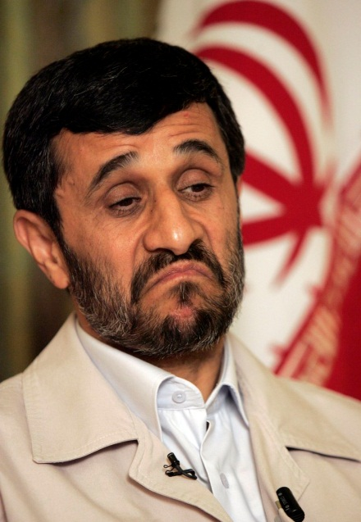
Weapon Design and Intent (1 of 2)
Activities of scientists
Declarations of leaders
High explosive testing
Increased activity at existing ordnance plants
Interest in explosives more powerful than TNT
Interest in fast-acting high-pressure gauges
Special equipment for melting and casting HE
Computer controlled machines for HE fabrication
Radiation monitoring equipment
Uranium in dust or debris
Weapon fabrication
Special security at a suspected assembly facility
Unusual import patterns – dual-use dilemma
Notes:
How might the activities of scientists tip us off that proliferation is occurring?
Have leader declarations always been true?
Korea vs. Iran
How have advances in computational power and computer modeling impacted the ability to model weapons?
How does the precision of modern equipment compare to what the US used in World War II?

Slide 10
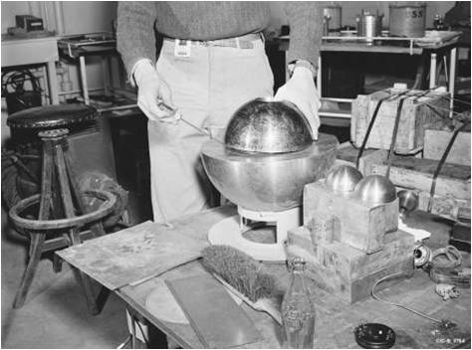
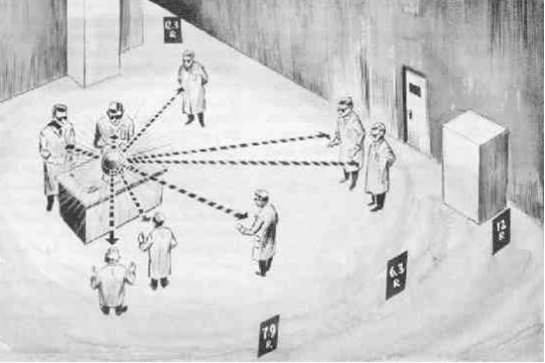
Weapon Design and Intent (2 of 2)
Nuclear laboratory experiments
Work on neutron initiators
Evidence of critical assembly accidents
Slotin incident
Los Alamos, May 21, 1946
Criticality experiment
Beryllium neutron reflector
Bare plutonium core
Re-creation of Louis Slotin incident and radiation exposure
Separation device (screwdriver) slipped, causing prompt critical
Blue glow of ionized air
Heat wave experienced by scientists in room
Fatal dose to Slotin; non-fatal to other scientists
Accidents can be a signature

Slide 11
Weapon Testing (1 of 2)
Visible
Satellite imagery
(U) United States Nuclear Detonation Detection System (USNDS)
“The United States Nuclear Detonation (NUDET) Detection System (USNDS) is designed to detect, locate, and report nuclear detonations (NUDETs) in the earth's atmosphere and near space in near real-time. The system is designed to support nuclear force management, integrated tactical warning and attack assessment, and test ban treaty monitoring. The system includes space based sensors and ground mission processing systems. The sensor payloads use NAVSTAR Global Positioning System (GPS) navigation satellites, and Defense Support Program (DSP) satellites as host platforms.“
Seismic signatures
Atmospheric releases
Gases
Particulates
Nuclear test site preparation
Notes:
What are the two types of seismic signatures?
P-waves and S-waves.

Slide 12
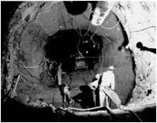
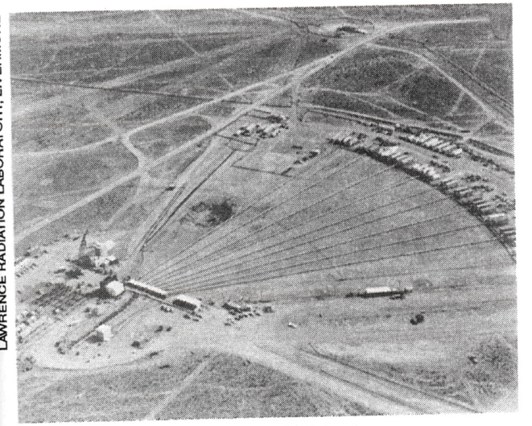
Weapon Testing (2 of 2)
Excavation of underground test tunnel (Nevada Test Site)
Schematic of underground test equipment and instrumentation
Test site location prior to 1966 underground nuclear test
Whether a country chooses to test a nuclear device at full yield or at reduced yields, a suitable underground site would be highly desirable
Notes:
Interesting factoid: My grandfather used to maintain the heavy equipment out at the Nevada Test Site!

Slide 13
Atmospheric Detection of Pathways
Uranium pathway is virtually undetectable via atmospheric monitoring
Reprocessing phase of plutonium pathway is most detectable via atmospheric monitoring
Recall: Intent is to recover fissionable material
Most radionuclides released into the atmosphere are gases and beta emitters (⁸⁵Kr, ³H, ¹⁴C as CO2)
Xe and gaseous and aqueous forms of Iodine (I) also released
Gamma emitting ¹³¹I concentration is close to background for power-related reprocessing but not so for military applications
Nuclear fuel generally designed for 150 day storage
Most fuel will be stored for much longer periods because of backlogs
This enables radionuclide gases to decay to insignificant levels except for ¹⁴C, ³H, ⁸⁵Kr, ¹²⁹I, and ¹³¹I
Notes:
Like I previously stated, atmospheric detection is just one example of a detection pathway.
Why might it be easier to detect an above-ground or shallow-burst?

Slide 14
Specific Activity after 150 days
 | PWR (33 MWd/kg; 30 MW/Mg) | LMFBR (37 MWd/kg; 49.3 MW/Mg) | HTGR (95 MWd/kg; 64.6 MW/Mg)
3H (Ci/Mg) | 690 | 1050 | 1090
85Kr (Ci/Mg) | 11,000 | 8430 | 60,800
131I, 129I (Ci/Mg) | 2.22 | 3.55 | 4.07

Slide 15
99% Efficient Kr Removal Concepts
Process | Status / Comments
Room temperature adsorption on charcoal or molecular sieves | In nuclear power plants, process used for xenon decay storage; simple operation principle; large beds required; charcoal poses flammability hazard
Low temperature adsorption on charcoal or silica gel | Pilot tested at reprocessing facility; smaller beds required; charcoal poses flammability hazard
Permselective membrane separation | Pilot tests; small equipment; no flammability hazard; mechanical failure problems
Cryogenic distillation | Pilot tested; small equipment; ozone explosion hazard
Chlorofluoromethane adsorption | Pilot tested; small equipment; no flammability hazard

Slide 16
Export Controls (1 of 2)
Export Controls
Delay the development of nuclear weapons in NNWS
Indicate procurement patterns of clandestine nuclear activity
Two main bodies for export controls of nuclear materials
The Zangger Committee
Nuclear Suppliers Group
Both report violations to UN for action
The Zangger Committee (1971 – )
Formed as a result of NPT treaty, which states that NWS will not export
Special fissionable material
Equipment to produce special fissionable material
Zangger Committee defined a “trigger list” of equipment in 1974
Nuclear reactors and components
Heavy water
Nuclear-grade graphite

Slide 17

Export Controls (2 of 2)
Nuclear Suppliers Group (1974 – )
NWS states including France and later many other major industrial states
Primary reason was to include France who had not at that time signed NPT
Largely duplicated the Zangger Committee
Duplication to encourage other nations to join one or the other
Enrichment and reprocessing equipment added to trigger list
Warsaw Guidelines established by NSG in 1992 agreed to control dual-use equipment
27 member states
Dual-use equipment was a loop-hole in the Zangger and NSG lists
Classic examples of dual use equipment was and is computers
Control is left to supplier rather than the UN
Full listing of parties and controlled items in OTA Appendix 4-D
Notes:
If you were to look at nuclear trafficking incidents worldwide, where would you expect the bulk of the occurrences to be? Why?

Slide 18
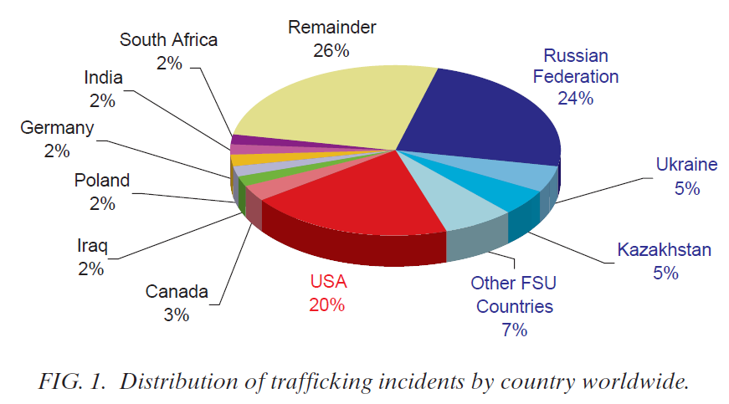
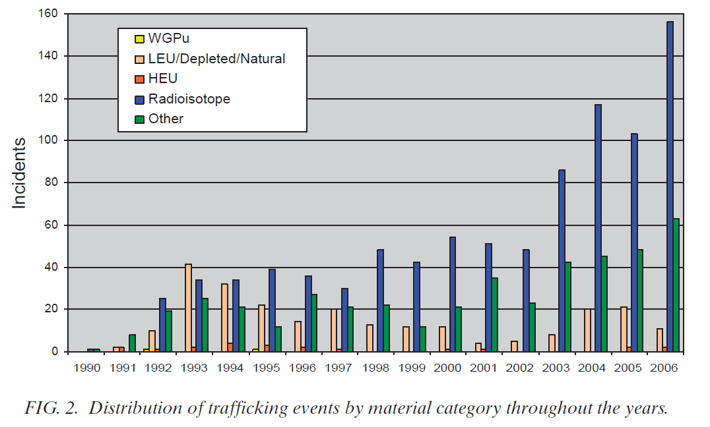
Assessing the Phenomenon of Nuclear Trafficking
Notes:
http://www-pub.iaea.org/MTCD/publications/PDF/Pub1316_web.pdf G.I. BALATSKY, W. SEVERE Los Alamos National Laboratory
Here is a breakdown on the distribution of trafficking events worldwide.
Note the US is the second largest culprit, after the Russian Federation?
It should be noted, that the report did not state the types of incidences by country.

Slide 19
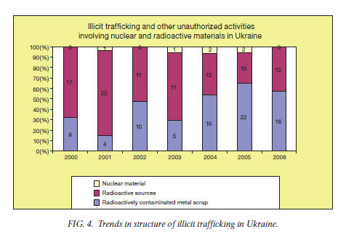
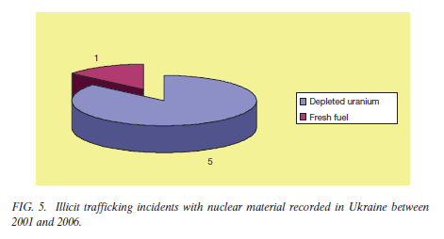
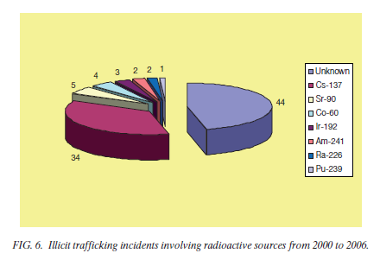
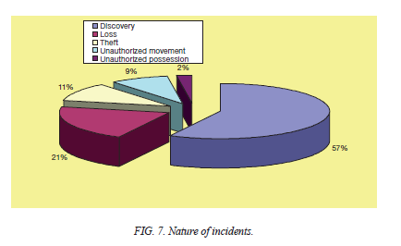
Assessing the Phenomenon of Nuclear Trafficking
Notes:
Same IAEA report: Ukrainian Efforts to Combat Illicit Trafficking of Nuclear and Other Radioactive Materials
From the same IAEA conference, the Ukraine self-reported.
Top-Left—note the number of incidents and breakdown.
Top-Right—in the six year period one incident of fresh fuel and five incidents of DU.
Bottom-Left—137Cs was by far the biggest culprit
Bottom-Right
The fact that discovery of materials indicates that there was (and possibly is) much material out there that is not accounted for.
Loss of material indicates the control and security mechanisms are not in place.

Slide 20
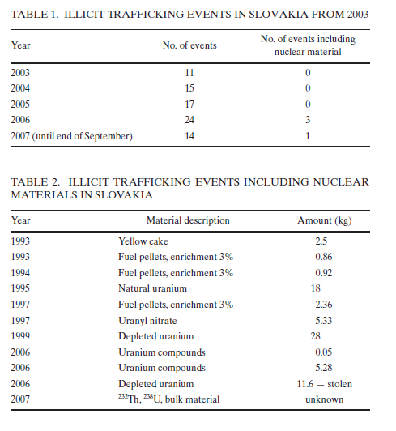
Assessing the Phenomenon of Nuclear Trafficking
Notes:
Same IAEA Report: Combating Illicit Trafficking in Slovakia (Vaclav)
Here is a breakdown on trafficking / incidents in Slovakia.

Slide 21
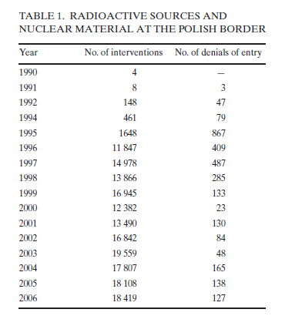
Assessing the Phenomenon of Nuclear Trafficking
Notes:
Same IAEA Report: Poland’s Experience in Border Monitoring (Niewodniczanski)
And here is a breakdown of material identified at the Polish border.
Note that an “intervention” basically means the alarm went off.
The denial of entry means that it was something that Poland turned away.

Slide 22
Conclusion
“The difficulty of producing fissile materials, however, limits the rate at which a proliferant could field nuclear weapons…
…Materials production would still provide the greatest opportunities for detecting such a program.”
– Technologies Underlying Weapons of Mass Destruction

Slide 23
Known Nuclear Powers
NPT Signatories (First Test)
US (1945)
Russia (1949)
Great Britain (1952)
France (1960)
China (1964)
South Africa* (1979)
Iran (Suspected)
Syria (Suspected)
* Dismantled stockpile in 1989
Non-Participants
India (1974)
Pakistan (1998)
North Korea** (2006)
Israel (Suspected)
** Withdrew from NPT in 1993
“The discovery of nuclear reactions need not bring about the destruction of mankind any more than the discovery of matches.”
– Albert Einstein
Notes:
Remember, there are only 5 NWS.

Slide 24
Chronology of Nuclear Treaties (1 of 2)
1963 – Limited Test Ban Treaty
Prevented above ground, underwater and outer space testing
136 nations have signed
1967 – Outer Space Treaty
Banned placing weapons in orbit or in outer space
129 nations have signed
1968 – Nuclear Non-Proliferation Treaty
Non-proliferation, disarmament, the right to peaceful nuclear technology
190 nations have signed
1972 – Strategic Arms Limitation Treaty I (SALT I)
Limited the number of anti-ballistic missile systems (US and Soviet Union)
US withdrew in 2001; Led to creation of the US Missile Defense Agency
1979 – Strategic Arms Limitation Treaty II (SALT II)
Limited number of strategic nuclear weapon systems (US and Soviet Union)
US withdrew in 1986 after accusing Soviets of violating the pact

Slide 25
Chronology of Nuclear Treaties (2 of 2)
1987 – Intermediate Range Nuclear Forces Treaty
Agreement between US and Soviet Union
Eliminated intermediate range (500 - 5500 km) ballistic and cruise missiles
1991 – Strategic Arms Reduction Treaty (START)
Agreement between US and Soviet Union
Limited number of nuclear warheads (6000) and delivery vehicles (1600)
1993 – Strategic Arms Reduction Treaty II (START II)
Further reduction of nuclear warheads (US and Soviet Union)
Russia withdrew in 2002 in response to US withdrawal from SALT I
1996 – Comprehensive Test Ban Treaty
Bans all nuclear testing (to include underground)
156 nations have signed
2010 – New Strategic Arms Reduction Treaty (New START)
Replaced START I, which expired in December 2009
Deployed warheads (1550); Deployed delivery systems (700)

Slide 26
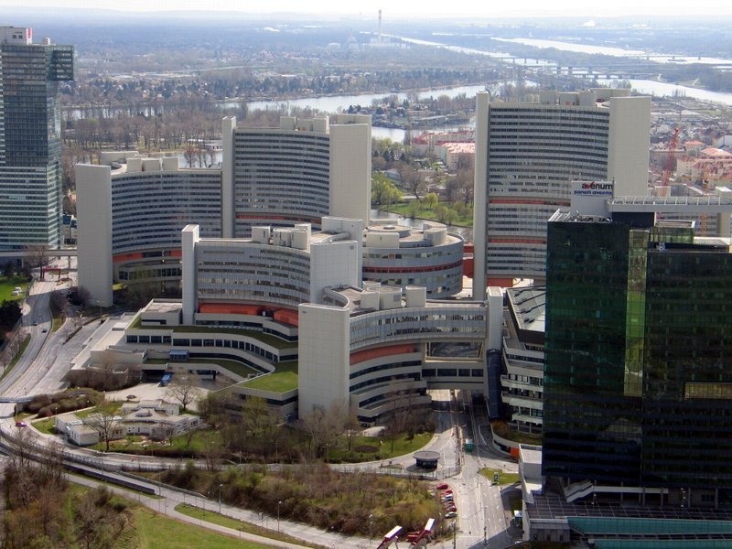
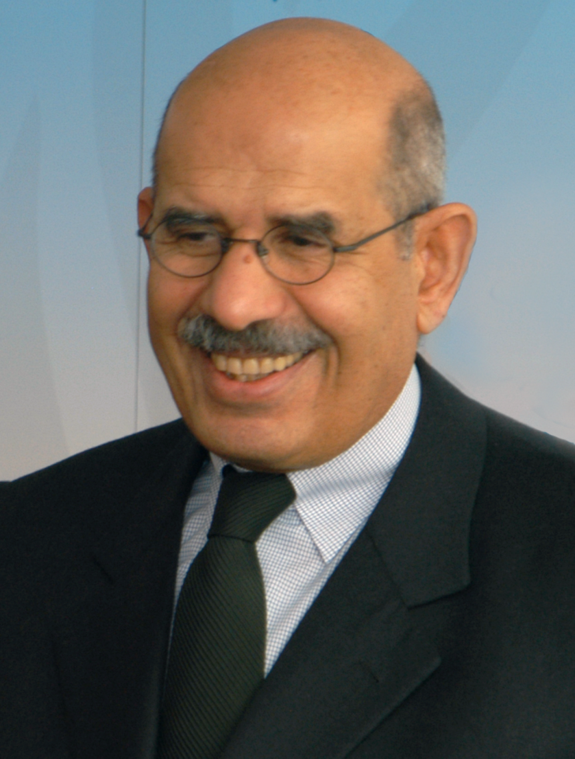

International Atomic Energy Agency
IAEA Headquarters – Vienna, Austria
Mohamed ElBaradei
Director General
1997 - 2009
Yukiya Amano
Director General
2009 - present
Regional Offices (2): Toronto and Tokyo
Liaison Offices (2): New York and Geneva
Laboratories (3): Austria (2) and Monaco

Slide 27
IAEA Safeguards and Procedures
Safeguards
Materials accountability
Containment
Surveillance administered by IAEA
Under the NPT
Non-nuclear weapon states (NNWS) must declare and place all materials under safeguards
Safeguards do not apply to the five Nuclear weapon states (NWS)
Procedures employed to ensure safeguards are met
Design review
Plant records
Plant operation: materials balance
Inspections
Initial, routine, special
70% of all inspections have been in Canada, Germany and Japan

Slide 28
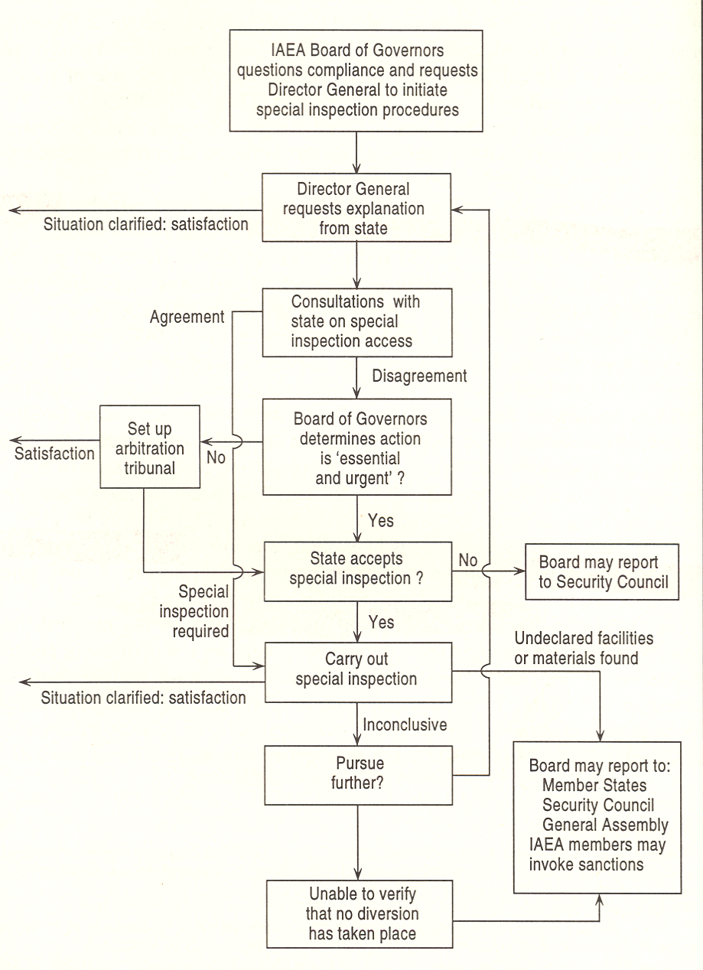
Limitations and Criticisms of Safeguards
Do not apply to
R & D of non-nuclear components
Peaceful uses of nuclear explosives (e.g. mining)
Lack of effective enforcement
Reprimand by UN Security Council
Iran: six reprimands from 2006 - 2010
Diplomatic pressure
There has never been a special (challenge) inspection
Debate about suspected activities in Iran
Bulk of budget for inspections in Canada, Germany, and Japan
Significant quantities of nuclear material
8 kg Pu; 25 kg HEU
Criticized as too high (Fat Man = 6 kg of Pu)
Procedures for initiating and carrying out special inspections (Kokoski, p.156)
Bureaucracy calisthenics, anyone?.....

Slide 29
Conclusions
“A successful proliferant must overcome a number of technical hurdles. Among them are: obtaining enough fissile material to form a super-critical mass for each of its nuclear weapons; arriving at a weapon design that will bring that mass together in a tiny fraction of a second, and designing a working device small and light enough to be carried by a given delivery vehicle. These hurdles represent threshold requirements: unless each one is adequately met, one ends up not with a less powerful weapon, but with a device that cannot produce any significant nuclear yield at all or cannot be delivered to a given target.”
– OTA, p.129
“The possibility of terrorists obtaining nuclear or other radioactive material remains a grave threat.”
– Dr. Mohamed ElBaradei, (Former) Director General of IAEA, 10/28/2008

Slide 30
State Motivations for Nuclear Proliferation
Slides taken from
Gordon Kohse with material prepared by Jacquelyn Yanch, 13 SEP 2012

Slide 31
Outline
Why do we want to know what motivates proliferation and why is it hard?
Some theory and models for state decisions to pursue or renounce nuclear weapons

Slide 32
Why try to understand proliferation motivation?
Addresses the “demand side” of proliferation control
May inform policy decisions to reduce proliferation
Complementary to “supply side” of proliferation control:
“Non-proliferation” – diplomatic, legal, administrative
“Counter-proliferation” – intelligence, law enforcement, military action

Slide 33
Very Basically
Make Proliferation Unattractive
Make Proliferation Difficult
Notes:
These are basically the two approaches to preventing proliferation.
Unattractive—you can make becoming nuclear armed unattractive; opportunity cost, etc
Difficult—putting barriers—physical, technical, and political—in place to make successful proliferation more difficult

Slide 34
A Useful Theory of Proliferation Motivation Should:
Be based on accessible data
Be verifiable
Have predictive capability
Deal with a range of possibilities and attitudes (e.g. preliminary exploration, dedicated program, “breakout”; proliferation, restraint, disarmament)
(Lead to practical policy insights – but this is not necessarily controllable)

Slide 35
So What’s the Problem?
States are neither monolithic nor static, nor is the environment in which they exist and interact
Necessary information is often secret, ambiguous or available only in retrospect
There are relatively few cases on which to test models
Proliferation/restraint decisions are sometimes difficult to separate from “supply side” obstacles

Slide 36
The proliferation environment
Manhattan project demonstrated it could be done.
Thereafter, one huge risk of having a weapons program (risk of a fundamental engineering or physics ‘roadblock’ to success) was removed.
“All” that is needed is:
Right materials
Lots of money
Technical and management expertise
Desire.
About 60 states operate, or are constructing nuclear power or research reactors, and more have recently expressed interest in nuclear power.
30 of these are estimated to have the industrial infrastructure and the scientific expertise to build nuclear weapons.
Currently, 9 states with nuclear weapons. Will there be more? Less?

Slide 37
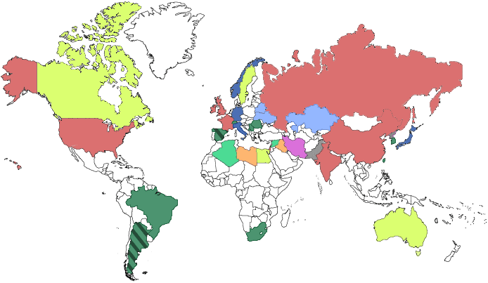
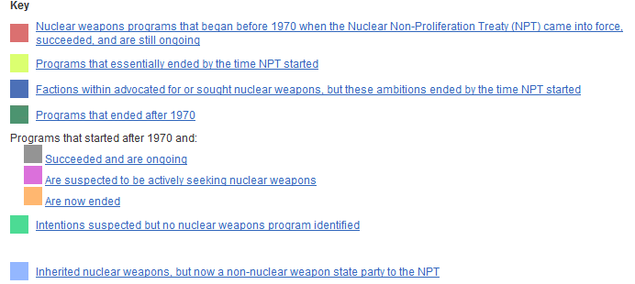
http://isis-online.org/nuclear-weapons-programs/

Slide 38
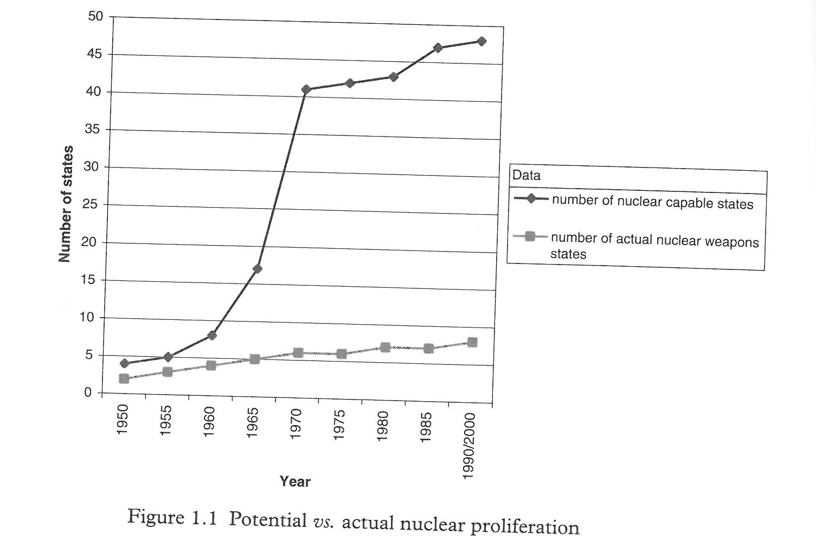
Minding the Gap
From The Psychology of Nuclear Proliferation, J.E.C. Hymans, Cambridge University Press, 2006, p.4 (based on Meyer and Stoll)

Slide 39
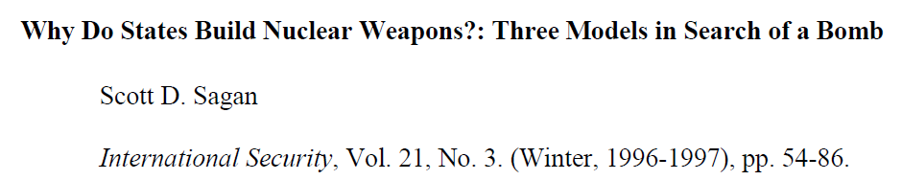
Sagan’s Approach
Three models by Sagan [Stanford U]:
1. Security model.
Neorealism theory in political science:
“States exist in an anarchical international system. There is no central authority, rather they must rely on themselves for security and protecting their sovereignty.” War is a natural outcome of this system.
- nuclear weapons, being very powerful, provide a measure of security in deterring attack from other states.
- but, if a rival state acquires nuclear weapons, this must be balanced by obtaining a similar nuclear deterrent.
→“Proliferation begets Proliferation”.
- Once country A has the bomb, prompting country B to develop the bomb, this threatens yet another state in the region (country C) which then feels it needs the bomb….
Strong states will develop their own nuclear weapons
Weak (poor) states must join an alliance with a nuclear state, depending on nuclear retaliation by that ally as a means of extended deterrence.

Slide 40
Domestic Politics Model
Domestic Politics Model:
Emphasizes role of bureaucratic or political interests of some individuals within the state.
Whether or not having a nuclear weapons program is in the best interests of the state, it is likely to serve the interests of, for instance:
State’s nuclear energy or research establishment (both from state-run laboratories or civilian reactor facilities
Sections of the military (often the Air Force )
Politicians in states where lobby groups or the mass public strongly favor acquiring weapons.
Bureaucratic ‘actors’ create the conditions that favor acquisition of weapons.
Encouraging extreme perceptions of foreign threats
Promoting supportive politicians
Lobbying for increased defense spending.
Focus is on domestic coalitions within the scientific/military complex
Innovative weapons-related ideas often come from inside state laboratories “where scientists favor military innovation simply because it is technically exciting and keeps money and prestige flowing into the laboratory.”
From this perspective, nuclear weapons programs are not inevitable solutions to international security problems, they are ‘solutions looking for a problem’.

Slide 41

Norms Model
3. Norms Model:
Sees nuclear decisions as serving important symbolic functions for the state.
Nuclear weapons may be seen as symbols of modernity, or of being an important player on the international scene.
Alternatively, relinquishing nuclear weapons can also be examined under this model, e.g. as demonstrating a peaceful world view, high levels of responsibility, etc.
Recall boast from Canada’s Prime Minister Trudeau:
"We are thus not only the first country in the world with the capability to produce nuclear weapons that chose not to do so, we are also the first nuclear armed country to have chosen to divest itself of nuclear weapons.”

Slide 42
Opposition Nationalism Model
4. Oppositional Nationalism Model
J Hymans [University Southern California]
Decision to acquire nuclear weapons arises from state leaders’ subjective perceptions of the nation’s international situation.
Oppositional nationalism represents a combination of fear of one’s enemy and pride in one’s nation.
These emotions lead people to seek symbols of power (whose practical utility may be doubtful).
For leaders of one national group in fear of another, a nuclear bomb can be the ultimate symbol of power and an immediate solution to the problem presented by the enemy.
Decision is based on emotions (fear and pride) rather than having a clear idea of how or when to use the weapons, or even or the long-term consequences of acquiring the nuclear weapon (arms race or nuclear war).
Pride without fear of an enemy = non-oppositional (sportsmanlike) nationalism. Does not lead to nuclear weapons since leaders will see no sense in paying the high associated costs (weapons program, security etc.)

Slide 43
Analytical Advantages Model
“Analytical Advantages” Model:
Etel Solingen [UC Irvine] Nuclear Logics: Contrasting Paths in the Middle East and East Asia, Princeton University Press, 2007
“analytical advantages of domestic models of political survival.”
Looks extensively at Middle East and East Asia
political leaders and ruling coalitions “advocating growth through integration in the global economy” will not be inclined to seek the Bomb.
Instead, beware of proliferation where “inward-looking leaders and coalitions” pursue political platforms “rooted in mistrust for international markets, investment, technology and institutions.”

Slide 44
All of the Above Model
6. All of the Above
Sonali Singh and Christopher R. Way “The Correlates of Nuclear Proliferation: A Quantitative Test”, Journal of Conflict Resolution 2004 Vol 48 p859
Extensive quantitative and statistical analysis of a complex data base intended to reflect technological, external and internal determinants for proliferation
Concludes that nuclear proliferation is well correlated with economic development and external threat environment
Note, however, that this work is descriptive rather than prescriptive and does not limit itself to motivational aspects

Slide 45
Summary of Motivations Modeling
We can examine the acquisition, rejection, and relinquishing of nuclear weapons by individual countries using these models.
Some countries fit one model better than others.
Most authors address past cases to demonstrate model validity, but do not make proliferation predictions
Some policy prescriptions are often presented but they are often contradictory or difficult to achieve.

Slide 46
Britain’s Nuclear Weapons:
The US McMahon Act of 1946 had threatened life imprisonment or death to anyone passing classified atomic information to any country, including wartime allies of Britain and Canada.
This dealt a blow to the UK who had been instrumental in the early days of the bomb development phases.
England’s industrial, technical and personnel capability had been severely curtained during the war due to heavy bombing.
Why did they need/want the bomb? Three reasons usually quoted:
Military – it was believed that the security of Britain (and the Commonwealth) depended on possession of the bomb
Britain faced the threat of Communist expansion;. No ‘nuclear umbrella’ in place.
before the NATO agreement,(1949) there was no assurance that the US would act to protect Britain if another conflict arose. Britain therefore needed its own weapons, target on centers crucial to its own defense.
Political –the bomb meant influence
with a nuclear weapon, Britain would be a credible participant in world affairs once more.
The bomb might lead to resumed (or at least partially) atomic relations with the US
Nationalistic
Britain's’ role as a world leader had been usurped by the US
The bomb would reaffirm Britain’s place as one of the ‘great powers’ of the world
“Without British help, especially in the early years, the atomic bomb would not have been available to the Americans in 1945.”
[McGeorge Bundy, National Security Advisor to Kennedy and Johnson]
“…the test will have a considerable effect on the American attitude towards atomic co-operation with the United Kingdom and indeed on Anglo-American relationships in general.”
[from the UK High Commissioner writing to Australian officials]
The British people reacted with a macabre surge of national pride. The tabloid London Daily Mirror exulted: ‘This bang has changed the world’. More seriously, Britain’s atomic test was regarded as a new deterrent to Communist attack and as a new incentive to restoring wartime atomic partnership among the U.S., Britain and Canada.
[American journal Newsweek reporting after the first test:]

Slide 47
France’s Nuclear Weapons:
France is an anomaly for the neorealists view of nuclear proliferation (ie the ‘security model’), both for acquiring the bomb and for the timing.
Nuclear program did not originate as a military-driven bomb program
France had been a leading nation in research in nuclear physics before WWII (Henri Becquerel, Marie Curie, Irene and Frederick Joliot-Curie, etc.)
After WWII France lagged behind
October 1945. The French provisional government under Charles de Gaulle issues a decree establishing the French Atomic Energy Commission (Commisariat a l’Energie Atomique, CEA) making France the first nation to establish a civilian atomic energy authority.
Frederick Joliot-Curie, France's most preeminent nuclear scientist, was made High Commissioner of the CEA
Joliot-Curie was a Communist, which kept France shut out of US, UK and Canadian nuclear activities.
Why did the French develop the bomb?
According to Sagan, France’s decision was to avoid being relegated to minor power status, “a fact inconsistent with its understanding of its historical rank and role.”
However, the instability of the Fourth Republic in France after the war and the lack of financial means held back French nuclear research which fell well behind that of the Americans. To some extent, American aid also prevented France from turning towards the military application of nuclear energy.
Was it a security issue? France did not make the decision after Hiroshima, after the Soviet’s tested Joe-1 (1949), after the UK tested in 1952, or after the US (1952) and then the USSR (1953). None of these events prompted the French to initiate a program.
Many in France in the early 1950s felt that their international prestige was best enhanced by developing a civilian nuclear program while keeping open the legal option to develop an weapon later.

Slide 48
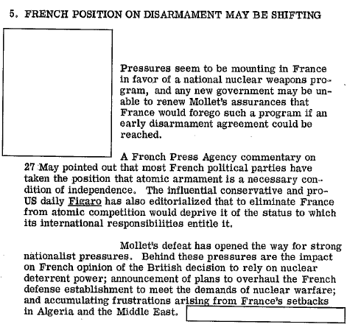
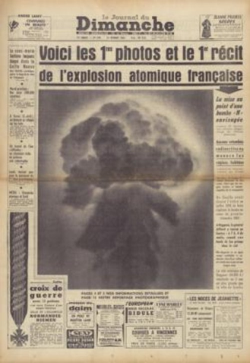
France’s Nuclear Weapons:
On 5th December 1956, a Committee for the Military Applications of Atomic Energy was secretly created.
Guy Mollet declared intention NOT to seek nuclear weapons.
This changed when Charles de Galle returned to power in 1958 and accelerated the nuclear weapons program.
First test in February 1960 in French Algeria, code named Gerboise Bleue [60-70 kT]
The first three French tests took place during a period of testing moratorium honored by UK, US, and USSR (1958-1961)
Now there are four nuclear powers….
CIA document from May 1957
http://www.gwu.edu/~nsarchiv/NSAEBB/NSAEBB184/FR09.pdf

Slide 49
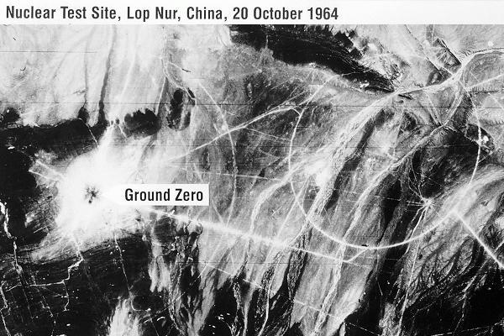
China’s nuclear weapons:
Mao Zedong decided in January 1955 to build the bomb because he believed China would not be taken seriously as a world power if they didn’t have nuclear weapons.
Mao did not want to be faced with ‘nuclear blackmail’ from the US, an issue that arose during the Korean war when The US effectively brought Taiwan under its protection.
Initial development of infrastructure of research design and production facilities took place with Soviet assistance.
an experimental nuclear reactor, facilities for processing uranium, a cyclotron, and some equipment for a gaseous diffusions plant.
Location for testing is a dried up lake-bed in a desert area of Xingjiang Province
Construction on the Lop Nur Nuclear Test Base began in April 1960
Lop Nur test site:
> 100,000 square kilometers; contains > 2000 km highways
Largest factory in the world by more than an order of magnitude
Has 4 distinct test zones; 3 underground, 1 atmospheric
First fission test on 16 October 1962 atop a 1021 meter tower
Code-named “596” after the year and month that Khrushchev refused to give them a prototype
May 1996, test of boosted fission weapon containing ⁶Li

Slide 50
China’s nuclear weapons:
The emergence of this ‘rogue’ state (so-called by Gavin because China at the time fit the description of ‘rogue’ as laid out by Georg W. Bush in the National Security document in 2002) forced the US to think long and hard about how to deal with emerging nuclear states, ie. nuclear proliferation.
The Johnson administration formed a secret committee (chaired by Roswell Gilpatric) to evaluate American counter proliferation policy.
Given free reign to step back and examine all policies and to recommend vast changes if needed.
The Gilpatric Committee identified four major counterproliferation options on a spectrum ranging from passive acceptance to aggressive rollback of nuclear capabilities.
accept proliferation as inevitable and work toward peaceful accommodation of multiple nuclear powers.
regard proliferation as a problem worth addressing, but not at the expense of other important foreign-policy goals. [This was existing U.S. policy.]
an activist policy, with a willingness to accept substantial costs and risks for counterproliferation.
The fourth and final option would call for an extremely aggressive counterproliferation policy, in which U.S. foreign policy would be dedicated to the pursuit of nuclear rollback.

Slide 51
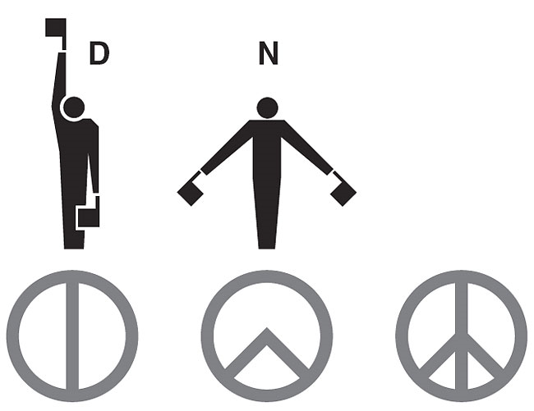


Growing Anti-Nuclear (weapons) movement:
By the mid 1950s concerns over radioactive fall-out and public protests of the nuclear arms race were building
Russell-Einstein Manifesto (Bertrand Russell and Albert Einstein) July 1955
1957 Albert Schweitzer’s (Nobel Peace Laureate) “A Declaration of Conscience”.
In 1957 the Committee for a Sane Nuclear Policy (SANE), an organization of private citizens, began pressing for a halt to weapons testing (with help of prominent Americans like publisher Norman Cousins and child-care expert Dr. Benjamin Spock).
January 1958, Linus Pauling and wife present to the UN a "Petition to the United Nations Urging the International Agreement to Stop the Testing of Nuclear Bombs Be Made Now," signed by 11,021 scientists. [Pauling earns a second Noble Prize (Peace) for this. He is the second of 4 people ever to receive the prize twice.]
Campaign for Nuclear Disarmament begins, 1957.
The first peace badge, 1958, made in ceramic for the Campaign for Nuclear Disarmament
Notes:
First Pugwash Conference – Pugwash Nova Scotia – in response to the Russell-Einstein Manifesto

Slide 52
Did public reaction have an impact on weapons testing? On proliferation?
Candidates running for political office have frequently used the issue as a platform (even up to time of Obama).
Politicians perceive the issue as impacting their electability.
On June 12, 1982, one million people demonstrated in New York City's Central Park against nuclear weapons and for an end to the cold war arms race. It was the largest anti-nuclear protest and the largest political demonstration in American history.
Difficult to measure and quantify the effect of the anti-nuclear movement.
Public reaction seems to be more against contamination of the environment (and the impact of this on human health) and less against the destructive power of the bombs, per se.
The late 1960s through 1980s saw a shift in the antinuclear movement toward protesting the development of nuclear power as an energy source.

